Slide 1



Macrosystems EDDIE: Getting Started + Troubleshooting Tips
Lofton, M.E., Moore, T.N., Thomas, R.Q., Carey, C.C. 07 March 2024.
Macrosystems EDDIE: Using Data to Improve Ecological Forecasts.
Macrosystems EDDIE Module 7, Version 1.
https://serc.carleton.edu/eddie/macrosystems/module7
Module development supported by NSF DEB-1926050; NSF DBI-1933016
Notes:
Welcome the students to class.
It is really important at this point to emphasize that there will be lots of new material covered during this module, and that going slowly and asking for help is very much encouraged!

Slide 2

R Shiny Applications
Statistical environment
Interactive web app built using R.
Allows users to interact with data
Conduct their own analysis
Check-in:
Can you access the Shiny app or this module?
Copy and paste this link into your browser: https://macrosystemseddie.shinyapps.io/module6/
If this is not working contact us at MacrosystemsEDDIE@gmail.com and we will help you resolve this issue.

Slide 3
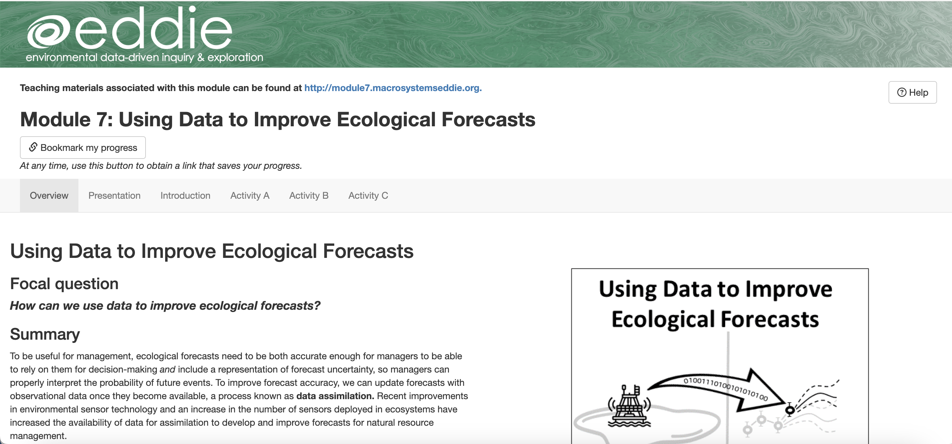
Landing Page of the Shiny App

Slide 4
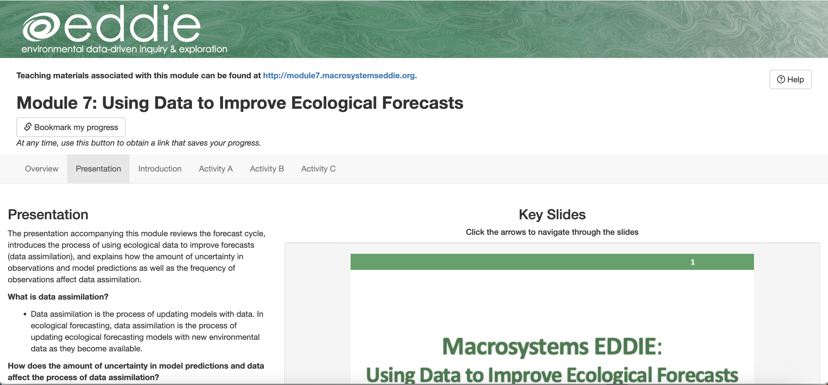

Navigating the Shiny App
Select a tab by clicking on it

Slide 5
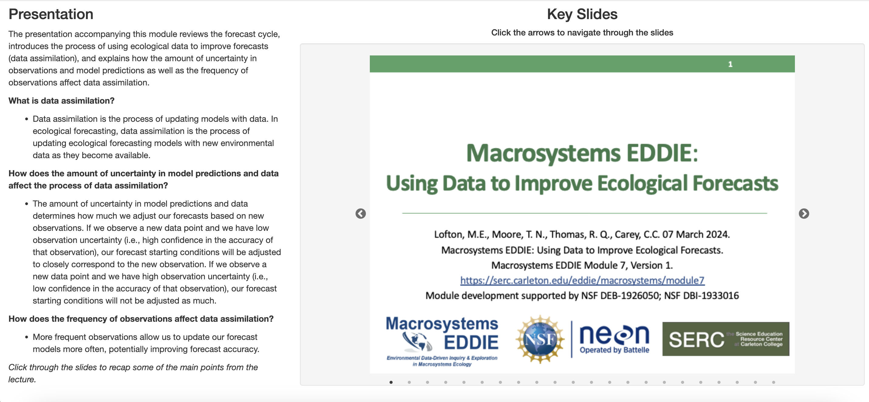
Navigate slides
Advance slides by clicking on the arrows

Slide 6
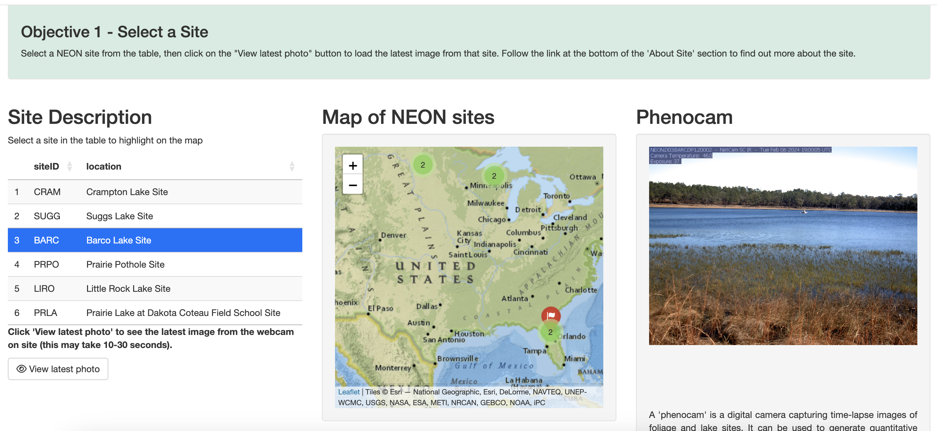
Interact with app
Select data table rows and click buttons

Slide 7
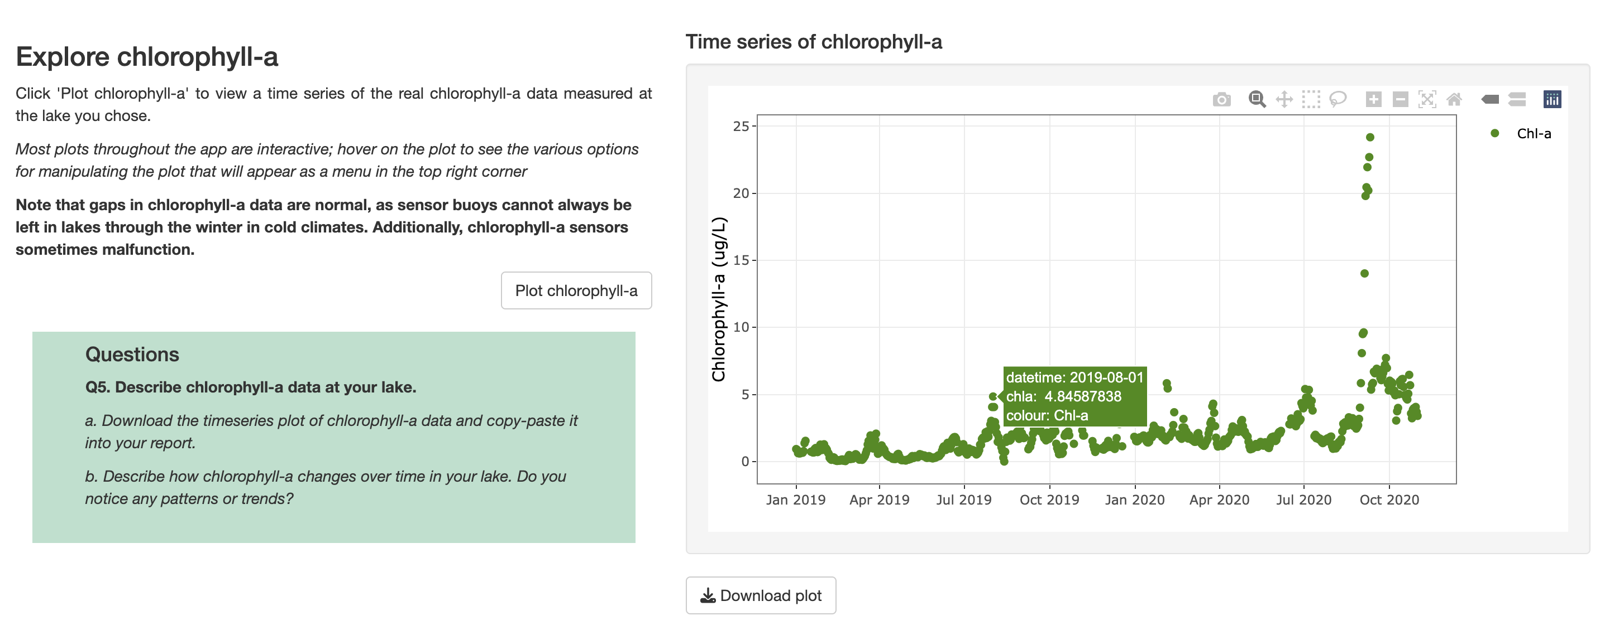
Interact with plots
Hover cursor over points or click and drag to zoom in
Hover cursor over plot to bring up options

Slide 8
Saving plots
Download plots to copy-paste into your final report

Slide 9
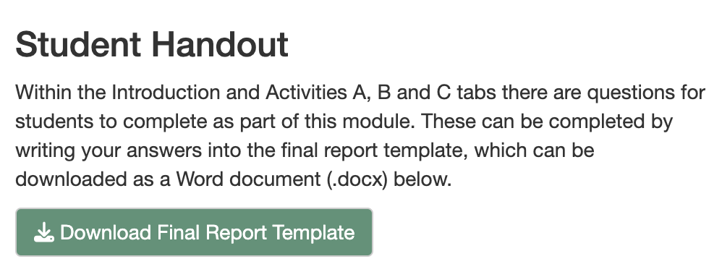
Downloading the Report
Navigate to the “Introduction” tab
Click on the “Download Final Report Template” button to download a Word document into which you can type your answers.
Notes:
Generating the student report. At this point, the instructor may choose to navigate to the Shiny app and demonstrate its features while screen sharing the app in a browser. Alternatively, the instructor may cover the material on slides 27-29 in PowerPoint.

Slide 10
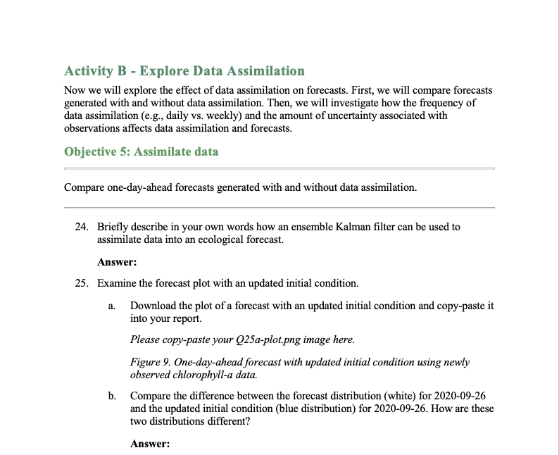
Answer questions
Type your answers into the final report template

Slide 11
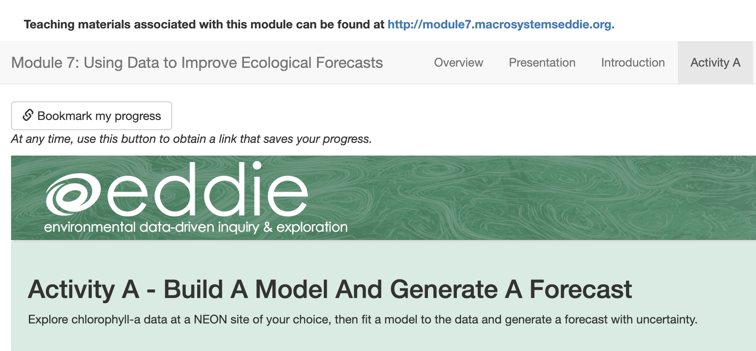
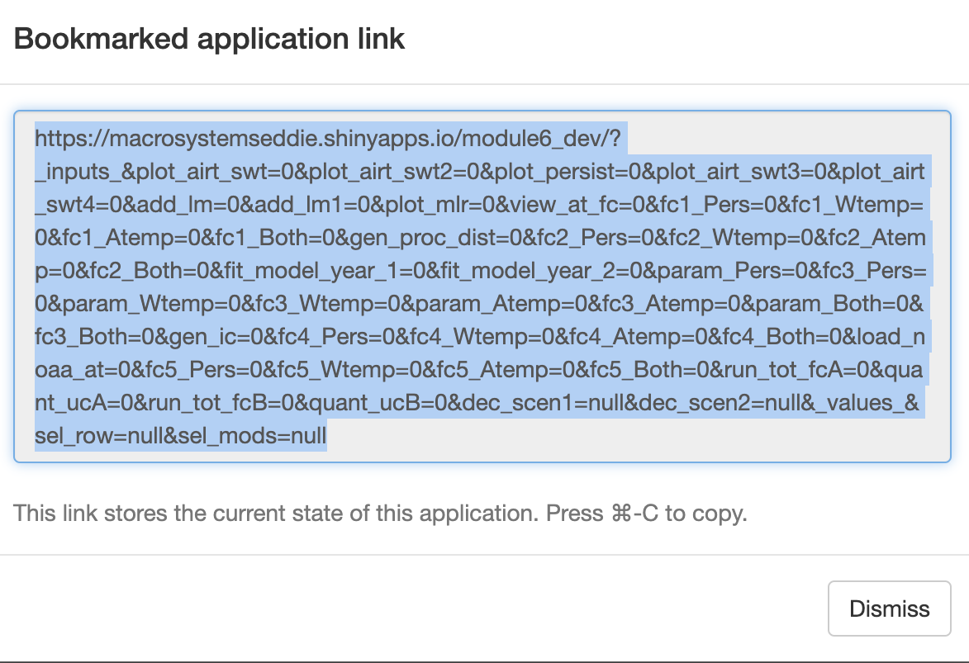
Saving & Resuming Progress
Saving Progress
Scroll to top of the page.
Click on the “Bookmark my progress” button. A pop-up window with a very long link will appear.
Copy-paste the link and store it at the top of your final report.
Resuming progress
Open your browser.
Copy-paste the link into your browser.
As you navigate through the tabs in the module, your progress will reappear.
Notes:
Saving & resuming progress in the Shiny app.

Slide 12
We recommend that you save your progress often!
Because the Shiny app can time out after inactivity (15 minutes) or disconnect if an internet connection is interrupted, we don’t want you to lose your work.
Save your progress as you go, as well as every time you close your computer or close the Shiny app in your internet browser.
After you save the link somewhere safe, you should be able to resume your progress where you left off!
Notes:
We recommend that you save your progress often!

